Slide 1
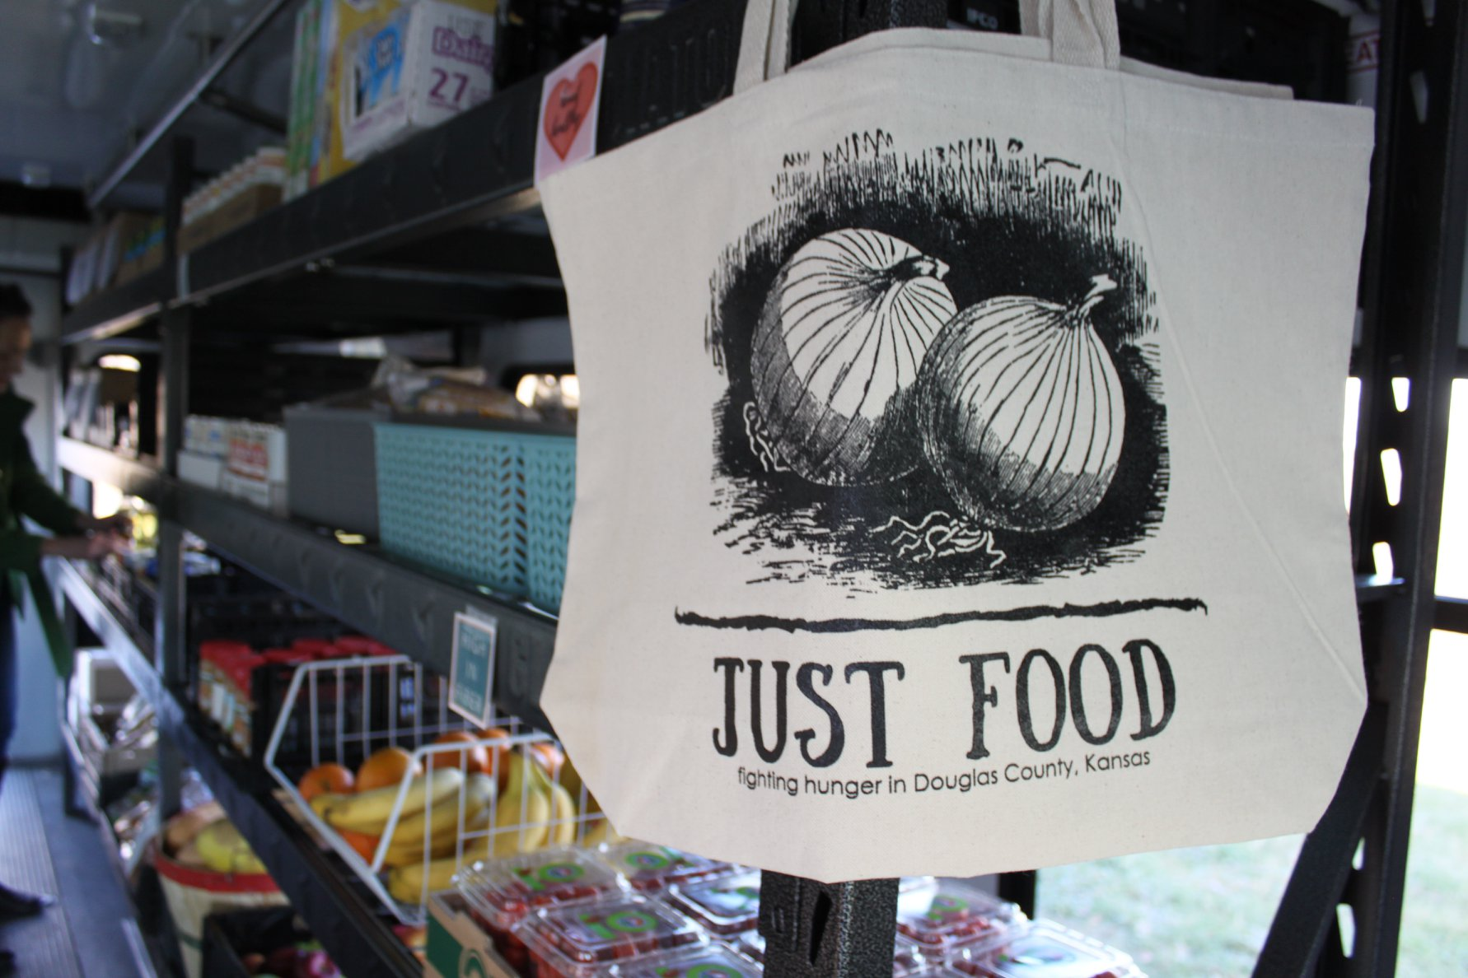
2018-2023 community health improvement plan priority: improving access to healthy food via a mobile food pantry
Notes:
Just Food (Jessica) – One of our most successful endeavors of 2019 was the unveiling of Just Food’s mobile pantry, the Cruising Cupboard. The idea of this was grown out of the 2018-2023 Douglas County Community Health Plan as well as the Just Food strategic plan when transportation emerged as a major barrier and became the top priority to increasing access to healthy food. The planning process was a direct result of discussion within the populations the mobile pantry would be serving. In Lawrence, 24,385 people live in a defined food desert, 50% of whom are below the poverty line while in rural areas 35% are below the poverty line and live in a defined food desert. Seeing these numbers, we knew something had to be done to help reach these populations. The Cruising Cupboard is a retrofitted small bus with wheelchair accessibility. One side is all shelving for non-perishable items while the other is two refrigerators and a freezer. Our main goal was to increase access to fresh and healthy food while still maintaining the total-choice model we have implemented in our pantry, allowing the shopping experience of our clients to be as close to a grocery store as possible. With the addition of the mobile pantry we are also able to distribute our senior commodity program as well as diapers to areas where these have long been unavailable. Before Covid-19, the mobile pantry was running every Tuesday with routes to Lecompton, Eudora, and Baldwin City, the three rural towns surrounding Lawrence and then the Lawrence Public Library on the last Tuesday of the month. We were lucky to receive GIS mapping of our client’s addresses overlaid on Douglas County food deserts to really see the spots that we have been missing and where our need is the highest. Through all of this we have seen the success that the mobile pantry is able to offer and with this grant we would be able to expand mobile operations to reach vulnerable populations more than once a month and at more than one location. Beyond rural communities, the mobile pantry helps to expand services to additional populations like those who are home-bound. Especially with the Covid-19 crisis, we have seen the need to include these services in our normal operations. Over the last two months the mobile pantry has been invaluable to continuing to serve our population in times of incredible uncertainty.

Slide 2
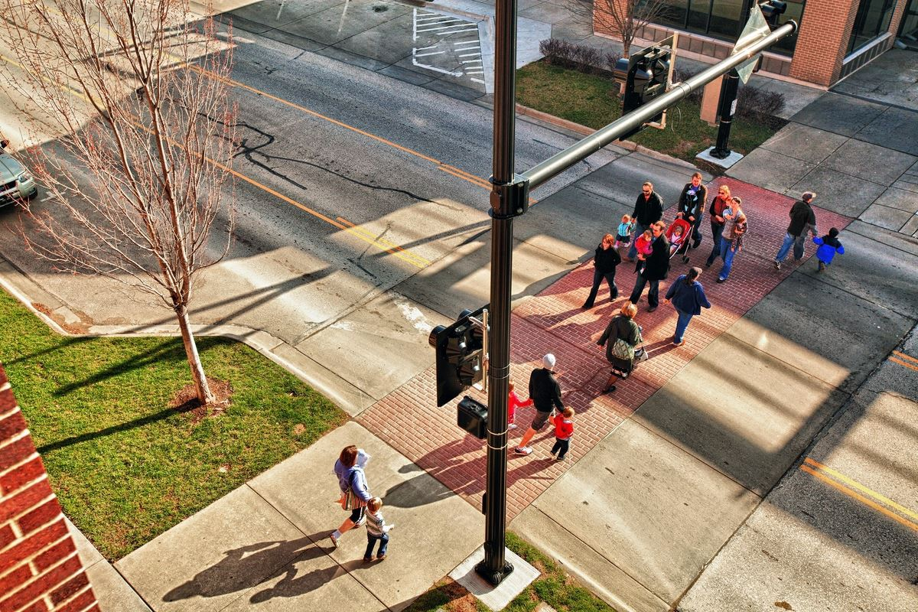
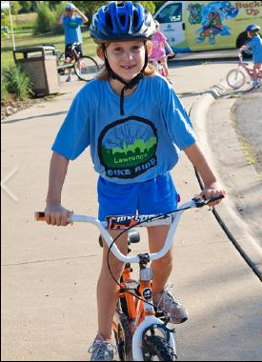
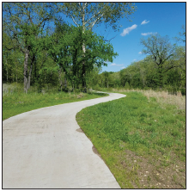
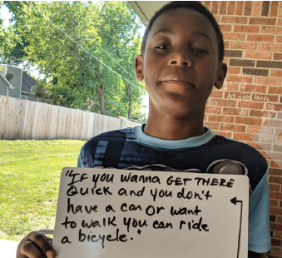
Promoting policy, system and environmental changes that improve opportunities for human-powered transportation
Equity & Discrimination
Notes:
Chris – We are seeking to facilitate community dialogue about coordinated strategies to implement existing local plans for walking, biking and transit. Planned efforts would include greater integration of public transit into multimodal systems discussions; accessing data on assets (bus stops, sidewalks, trails and bicycle amenities, etc.) to measure and publicly communicate progress towards enhancing the built environment for active transportation; utilizing tools such as the Kansas Health Institute Health Impact Checklist and the Lawrence-Douglas County Public Health Equity Impact Assessment Tool to examine impacts/potential impacts of projects on health equity in order to contribute to discussions of project prioritization; evaluating progress on local bike and pedestrian plans and overall multimodal system improvement using recognized instruments like the Bicycle Friendly Community and Walk Friendly Communities Program ratings; and ensuring effective communications community-wide about overall progress.

Slide 3
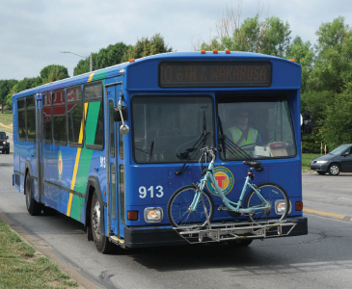
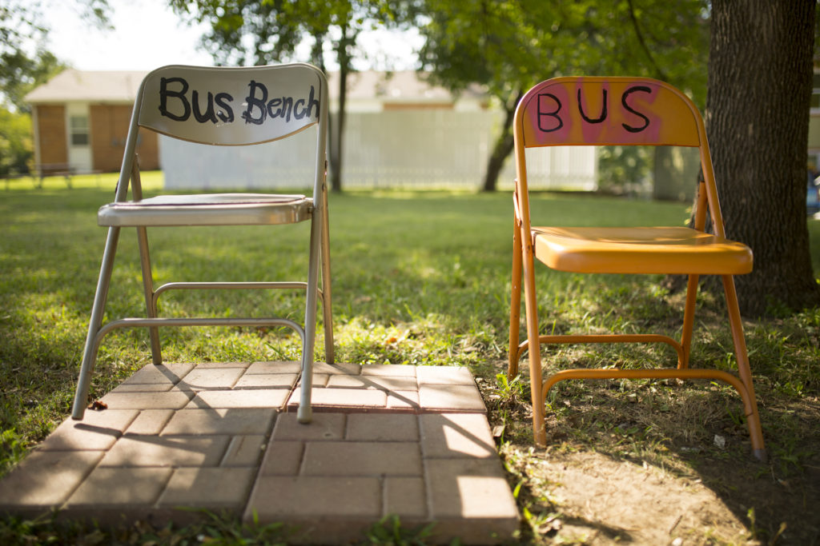
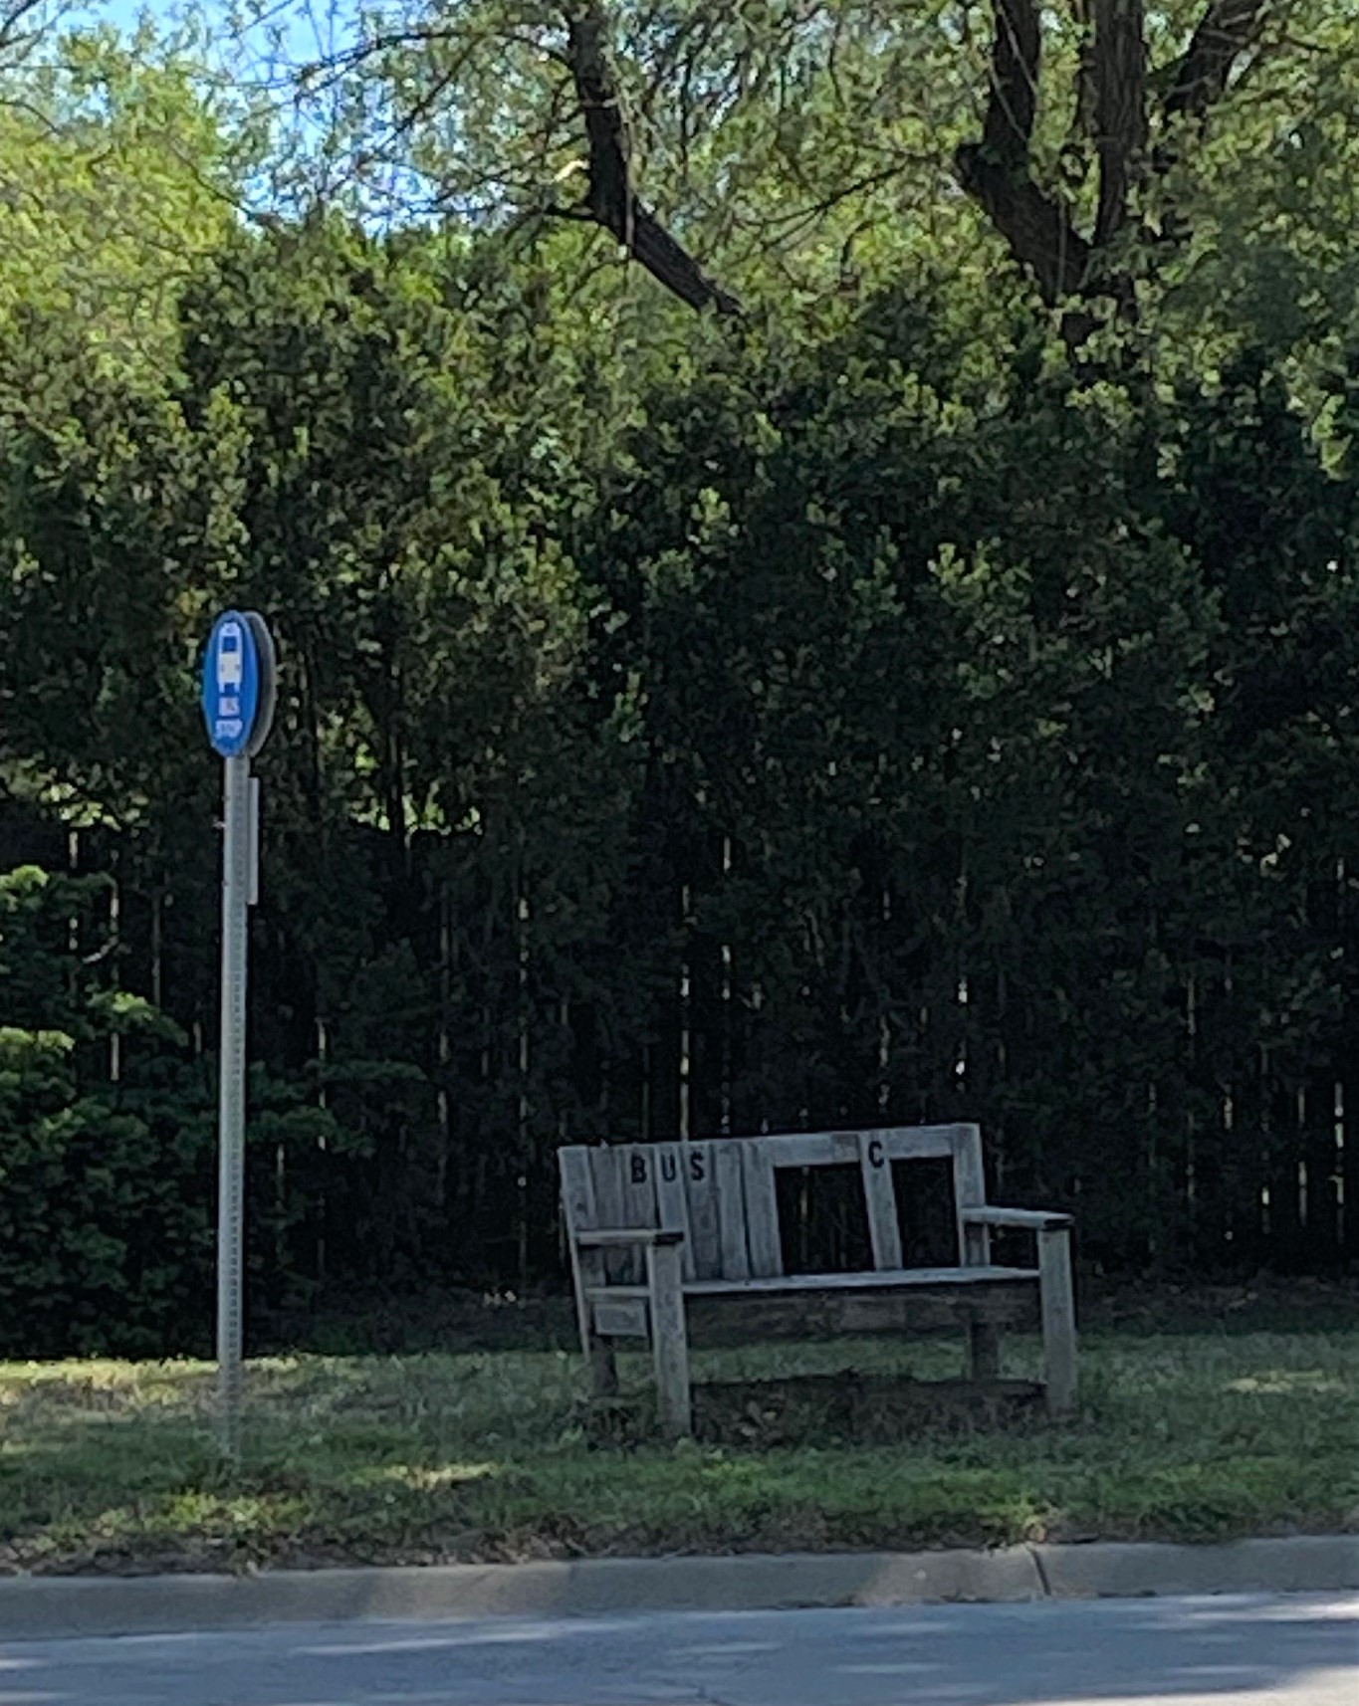
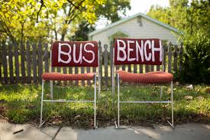
Community engagement to make transportation more accessible
Notes:
Jeff - Making transportation more accessible through a community-engaged processes to add bus stop amenities.

Slide 4
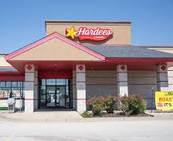
Reducing effects of local food desert by reducing barriers to healthy food
Notes:
Just Food (Liz) - As we mentioned in slide one, transportation barriers and lack of access to healthy food is a growing concern in our community. Some rural communities have little to no consistent access to fresh food like produce. The proposed approach to grow “Safe Routes to Food” in our local food deserts is two-fold: 1) Seek systems change to make Lawrence Transit more accessible, such as through zero-fare public transport. Lawrence Transit receives a small proportion of its bus fares from rider fees, and these fees disproportionately burden low-income residents. There has been local conversation and energy to consider elimination of bus fares, and we believe this grant opportunity will provide the dedicated resources needed to successfully engage the community to carry this issue forward. 2) Grow efforts to reach vulnerable populations with Just Food's Cruising Cupboard mobile food pantry (which reflects the goals and strategies outlined in the 2018-2023 Douglas County Community Health Plan). In 2019, Just Food obtained funds for and retrofitted the Cruising Cupboard, but it currently operates only one day each week.

Slide 5
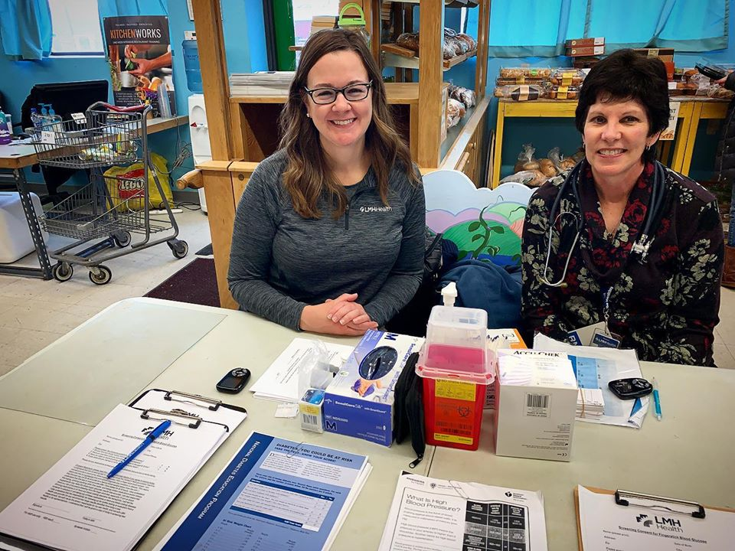
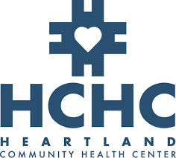
Growing “hunger and health” initiatives and healthy food prescription programs
Notes:
Ryan -
We know that minority and lower-socioeconomic communities have a higher rate of food related illnesses such as diabetes, high cholesterol, and high blood pressure than the general population. And at Just Food, we found that the majority of our clients were dealing with these health related illnesses as well. 37% of Households have a member with high blood pressure, 62% have a household member with type 2 diabetes. We partnered with Lawrence Memorial Hospital (LMH) to better serve our clients and try to bridge the health care gap by having the hospital come to us, and Just Food come to the hospital. We were able to do this by providing free monthly health screenings at the Just Food pantry. Clients are able to get their blood pressure and blood glucose as well as quarterly cholesterol screenings. Alongside that, LMH doctors are able to write healthy food prescriptions. Just Food has provided them with ‘prescription pads’ to identify what food can help with their ailments and clients are then able to bring in the “prescription” to the pantry to supplement specific food needs. This provides our clients with a look into their own health and how to make food decisions that are best for their individual diet. Beyond that, we also provide emergency meal bags for LMH patients. Across multiple departments at LMH, if a client screens as food insecure they are provided with a meal bag containing a resource guide and enough caloric intake to sustain them until they can get to a food pantry. In the first year of the program, 124 Just Food Bags have been distributed to LMH Health patients via the Emergency Department and Social Work Departments. 118 Just Food Clients have participated in a monthly screening since January. Finally, last fall we were able to open a satellite pantry at Heartland Community Health Center called The Care Cupboard. The Care Cupboard is open to patients at Heartland during the time of their appointment as well as select community hours. Our goal was to limit barriers to attaining healthy food, and being able to provide the needed items to patients at the time of their appointment was a great first step. As we continue to grow our hunger and health initiatives, we know that there is a lot of work to still be done but we hope to continue closing the hunger gap through the healthcare lense. Each year, the Care Cupboard served over 3,000 Douglas County residents. Although these programs have been successful in providing clients with an idea of where to go from here in regards to their own health, we feel that with additional resources, we will be able to close the gap for a lot of our patients by being able to purchase more healthy food for our pantries for patients to access, open more pantries or access points for patients, and create a system that track and closes the loop of patient prescriptions needs.

Slide 6
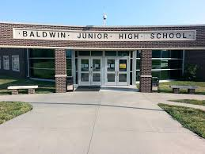
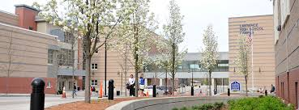
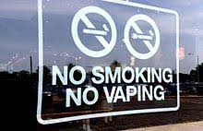
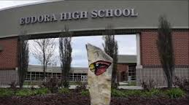
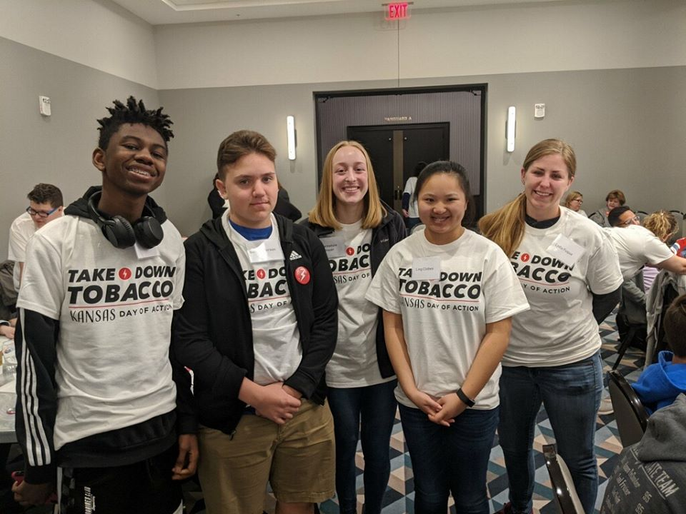
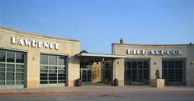
Working with youth & local school districts to identify and implement PSE changes for vaping prevention
Notes:
Aftan - Our public school systems have previously introduced mandatory vaping curriculum into the classroom. However, additional preventative measures are needed to effectively address the vaping epidemic. Our TFL workgroup closely works with Denise Johnson, Lawrence Public School’s Assistant Director Health & Wellness to integrate vaping education into the schools. Last Fall, Denise collaborated with Eudora Public Schools for both communities to bring in a national speaker on vaping. LiveWell helped with this event. We also have some group members that are tobacco treatment specialists and have been working with school administrations offering vaping education to the students as well as cessation implementation that are willing and in need. Our workgroup has been working on policy work to advance the Tobacco 21 policy for our community. Since December of 2019, T21 passed on a federal level and our state T21 bill fell through in the midst of COVID this Spring. Our workgroup has since discussed moving forward with the local policy but agreed to wait until our pandemic calms down. We are currently considering implementation and monitoring of data analysis for schools’ existing vaping curriculum where we can provide that data to Lawrence Douglas County Public Health and help train or adjust such curriculum in the schools, as needed. We will also be working with local schools to implement policy and practice changes to support students’ vape-free behavior.

